Slide 1

SAM / SMC: Call Locations – Wisconsin 2024
How to configure and troubleshoot
2023

Slide 2
Service Field Location Required in Wisconsin EVV Jan. 1 2024
Effective Jan. 1 2024, records submitted to the Wisconsin Sandata Aggregator by an Alt EVV vendor must indicate the location of each visit and specify home or community in the service location field for a visit to be validated.
Home is defined as the beneficiary’s address listed in EVV.
Community is defined as any/all other locations other than the beneficiary’s home address.
When the service location field is not completed, Aggregator will display an exception: Missing Location
Alt EVV vendors are required to work with Sandata to identify system updates or modifications needed to include the home or community service location field with their verified visits that are transmitted to the Sandata Aggregator.

Slide 3
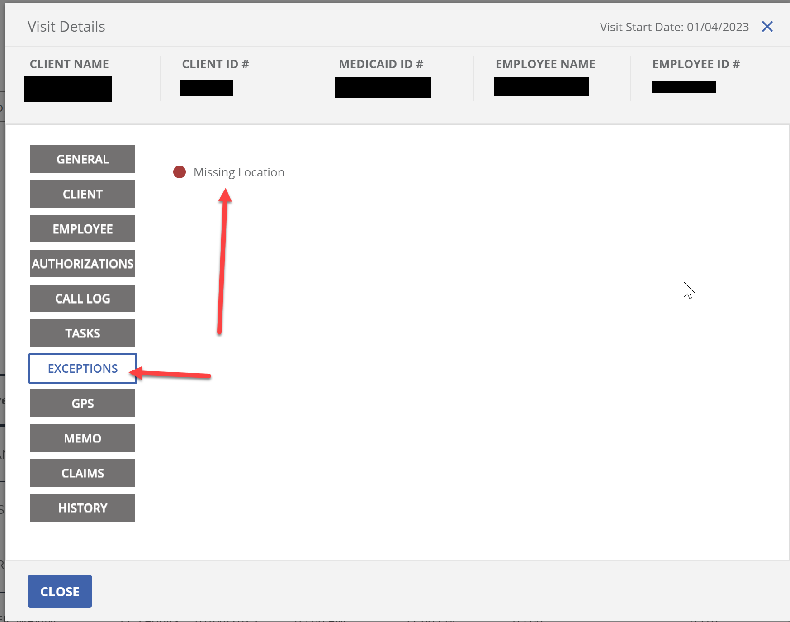
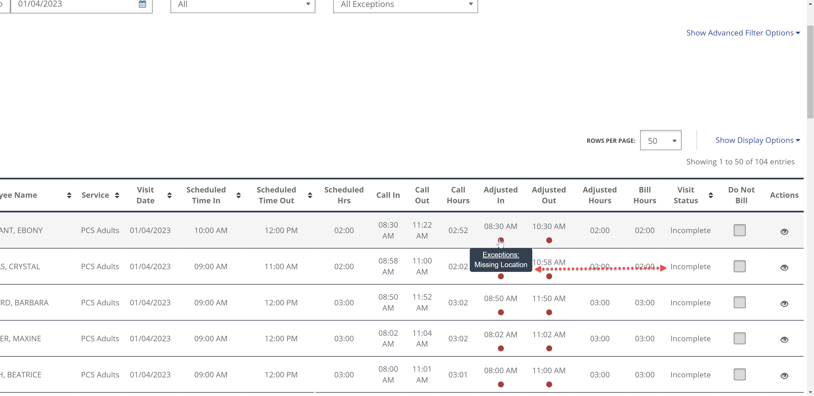
What to look out for:
Does the Payor have Call Location enabled?
If Call location is not enabled at the payor level: The schedules still may appear in aggregator but with a status of Incomplete. We want it to say Verified
  Hover over the call times you will see the exception: Missing Location.

Slide 4
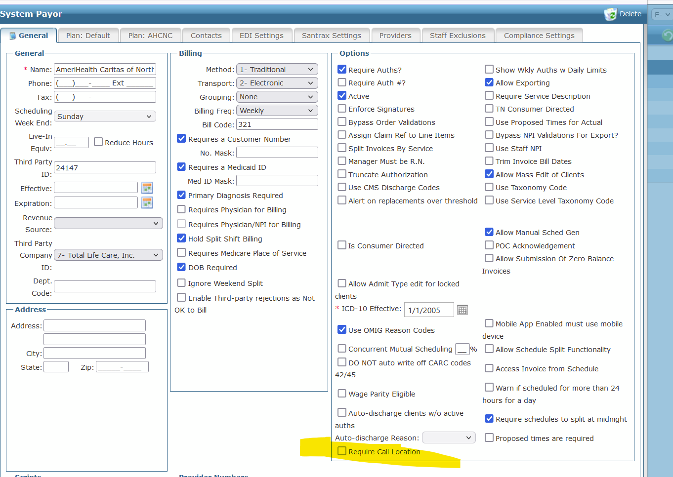
How to Troubleshoot:
Step 1:
Go to the payor > Look in the section called Options > Make sure Require Call Location is enabled ( has a check). If disabled, then enable it and click SAVE.

Slide 5
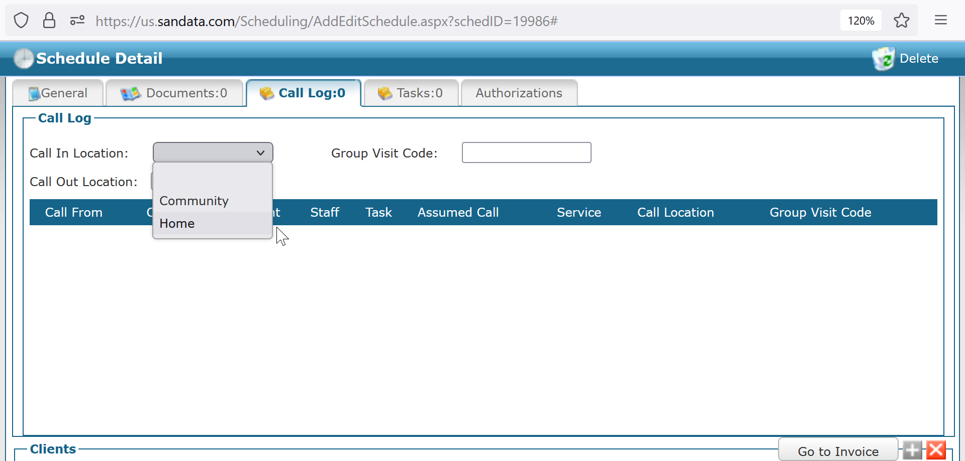
Step 2:
Go to the schedule detail screen > click on the Call Log tab > The call locations should not be blank.
It must have Home or Community selected for Call in and Call out.

Slide 6
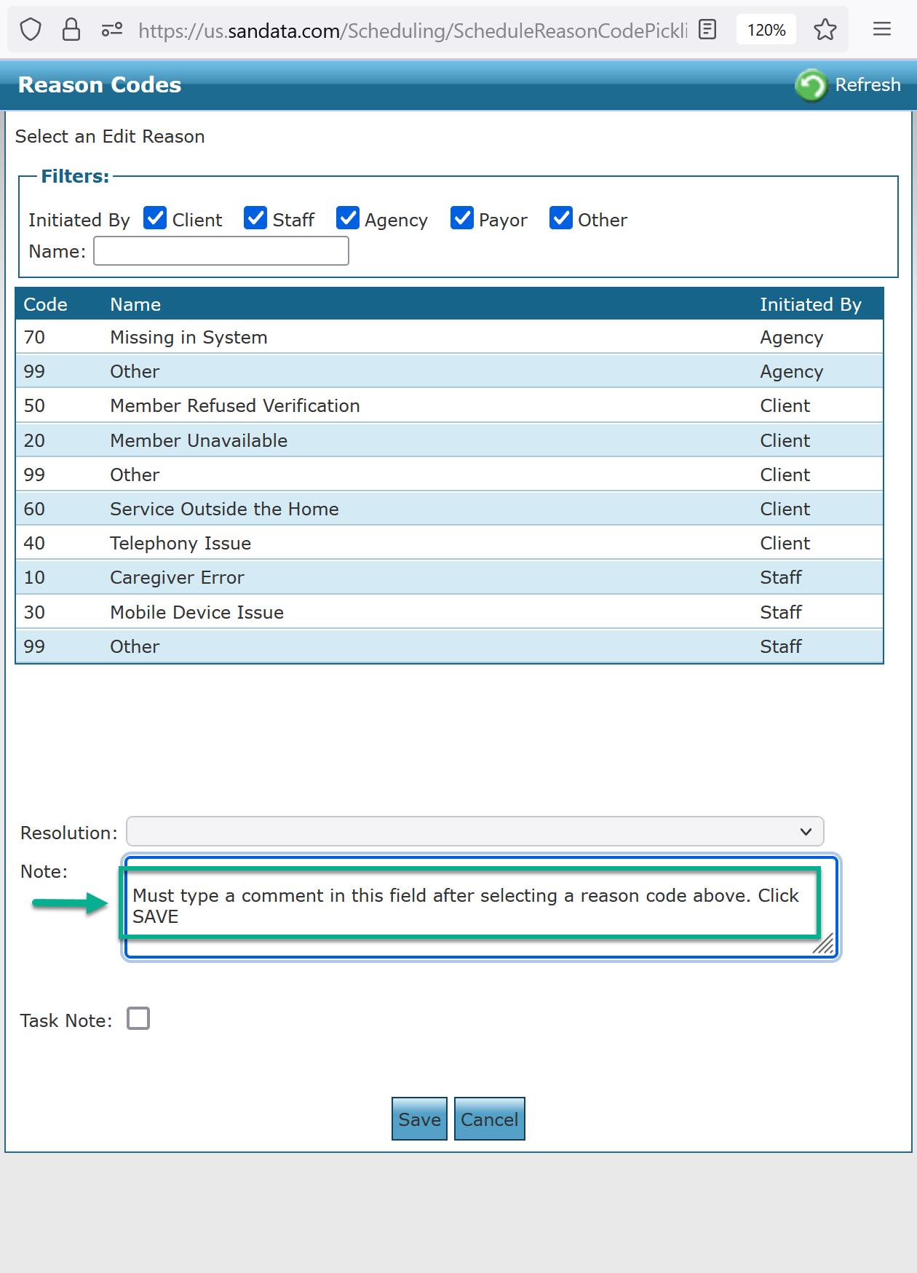
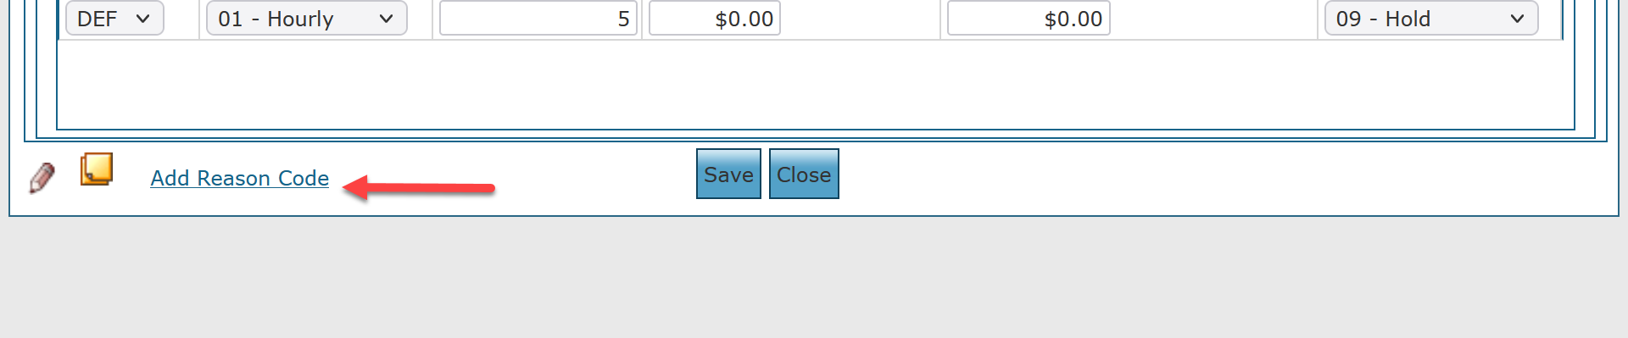
Step 3: Add an edit reason code and comment
After adding the call location, a Comment and Edit reason code must be added.
Click on Add Reason Code, in the bottom left corner of the schedule detail screen
Type in a comment > Click on a Reason Code
> Click Save > Click Save on the schedule Detail Screen

Slide 7
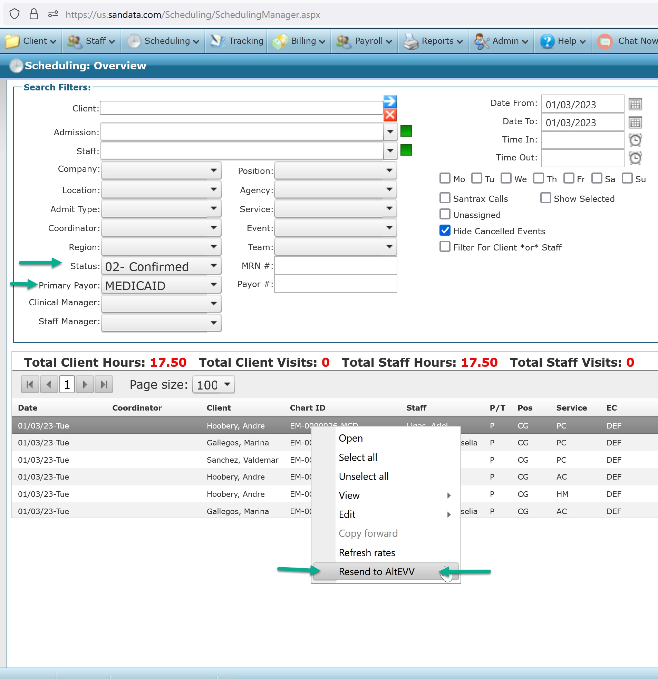
Step 4: Resend to Alt EVV
Once the call location, edit reason code and comment have been added, the schedules must be resent to the aggregator using the Resend to Alt EVV process
Visit Maintenance > Select the Status > Select the Primary Payor > Refresh > Left click the Schedule(s) > Right Click > click on Resend to AltEVV
Check Aggregator and the EVV Transaction Status report after the next push from SAM to Aggregator
( 7am, 12pm, 5pm eastern)

Slide 8
Get it right from the start with the state,
your provider network, and your members.

